Slide 1
Gendered Job Postings
Kyle O’ Brien, Nikhil Dodd, Bryan Jimenez, Jerico Factor

Slide 2
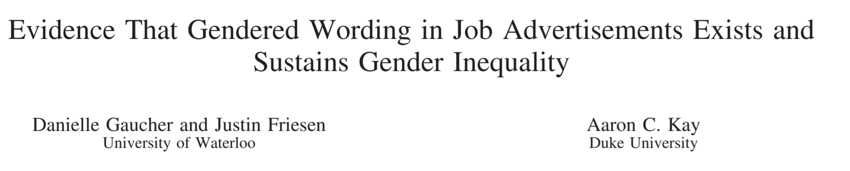
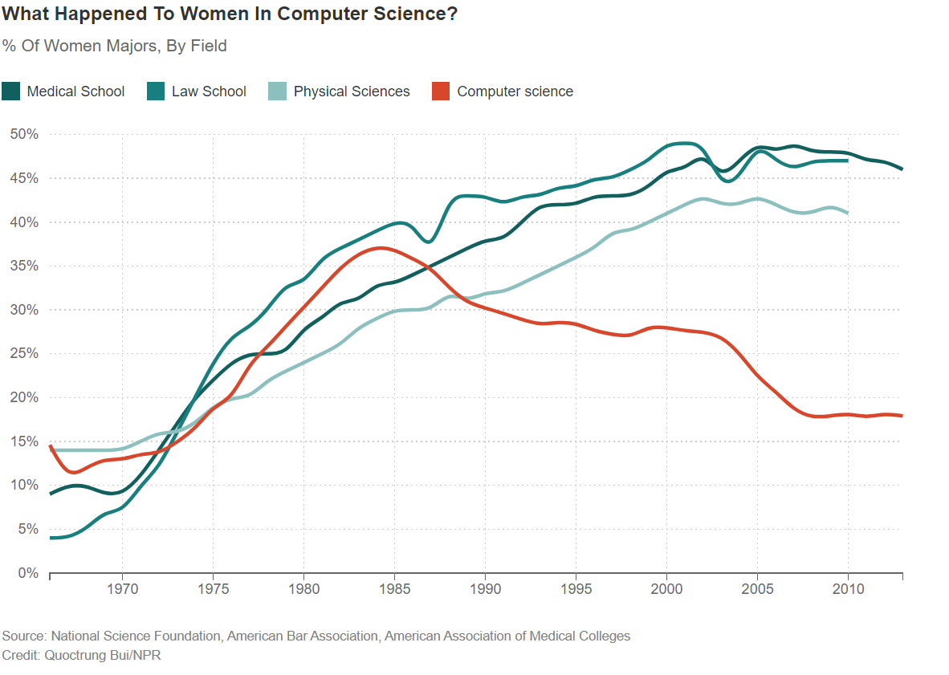

Motivation and Data
Questions Explored
What percentage have gender pronouns in the job posting?
How are gendered job postings distributed across the USA?
What are the most common roles in tech that have gendered job postings?
Out of the gendered words/phrases, which are the most common?
Find the correlation between phrase usage and location (are certain phrases being used more based on the origin of the company/where posting is coming from)
Data: ~21k Tech Industry Job Postings
Glassdoor, Dice, Indeed, Monster
Kyle1668/gender-specific-pronouns-analysis

Slide 3
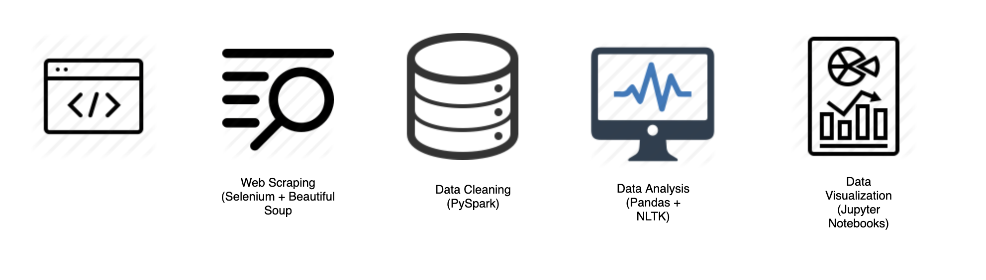
Approach
Kyle1668/gender-specific-pronouns-analysis

Slide 4
Visualizations and Results
Wrote an algorithm that found all the jobs that had descriptions that used words/phrases from our list
Used NLTK to retrieve any stems from our master list of phrases and searched for those stems in the job descriptions
We wanted to derive the stems from the job descriptions as well to determine which ones appear most by state without any main list restricting us
Instead of using our master list, we generate our own and determine if the word was masculine or not
Kyle1668/gender-specific-pronouns-analysis

Slide 5
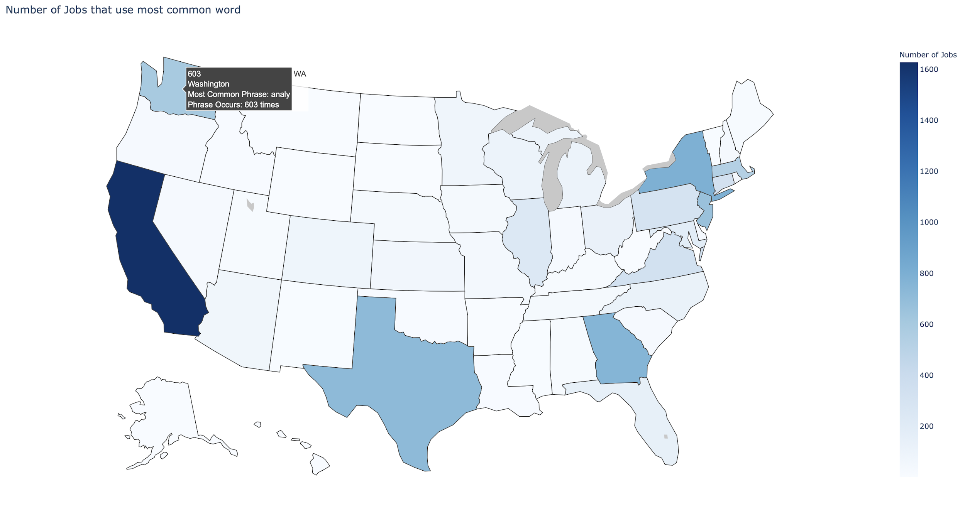
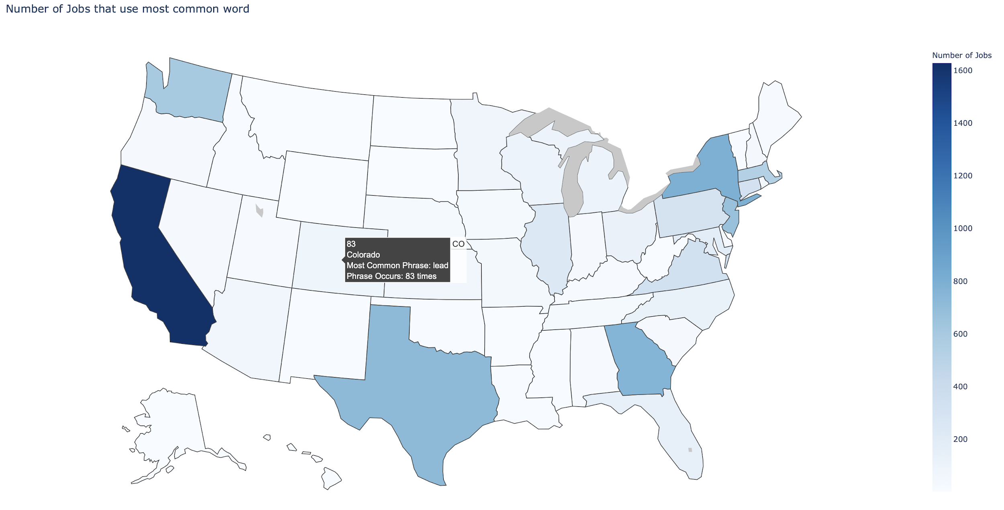
Visualizations and Results (Continued)
Kyle1668/gender-specific-pronouns-analysis

Slide 6
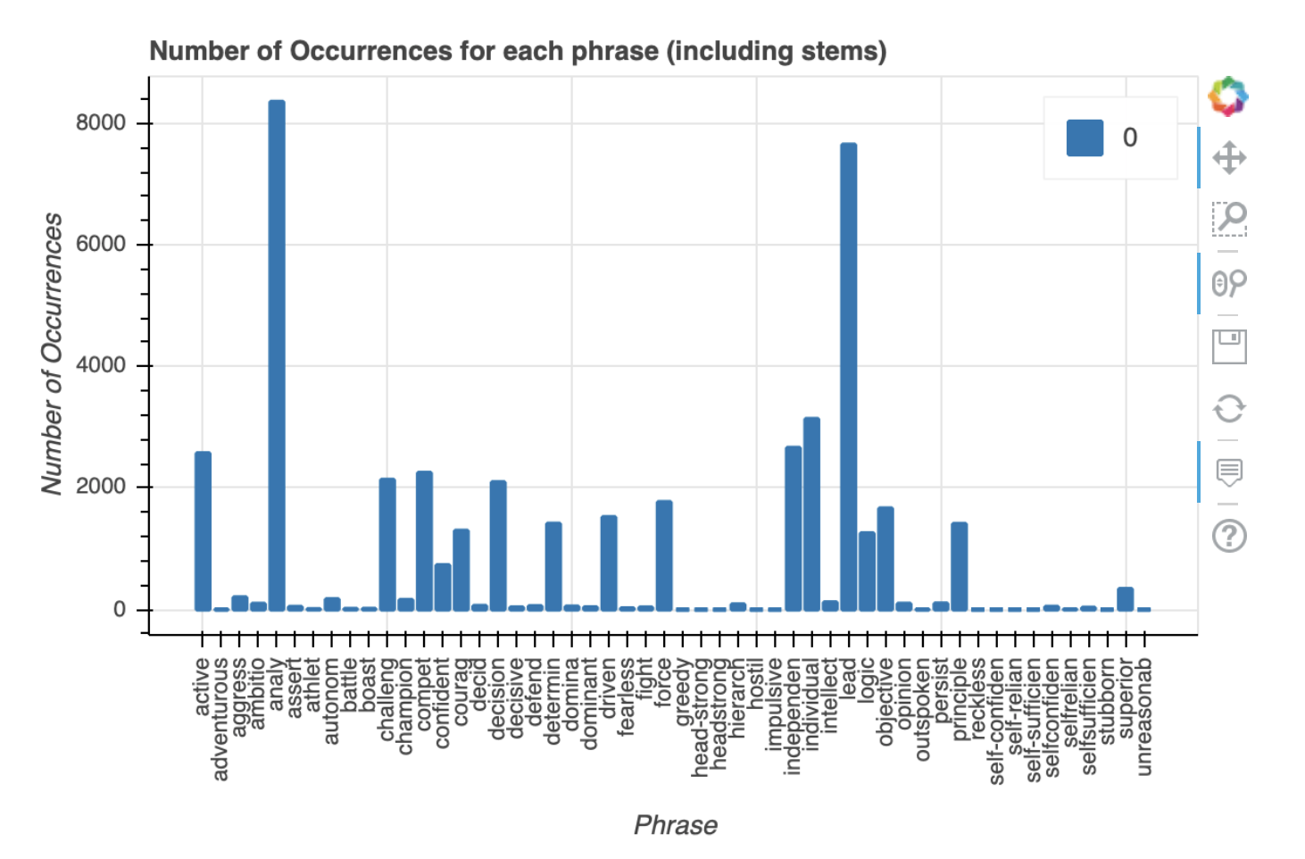
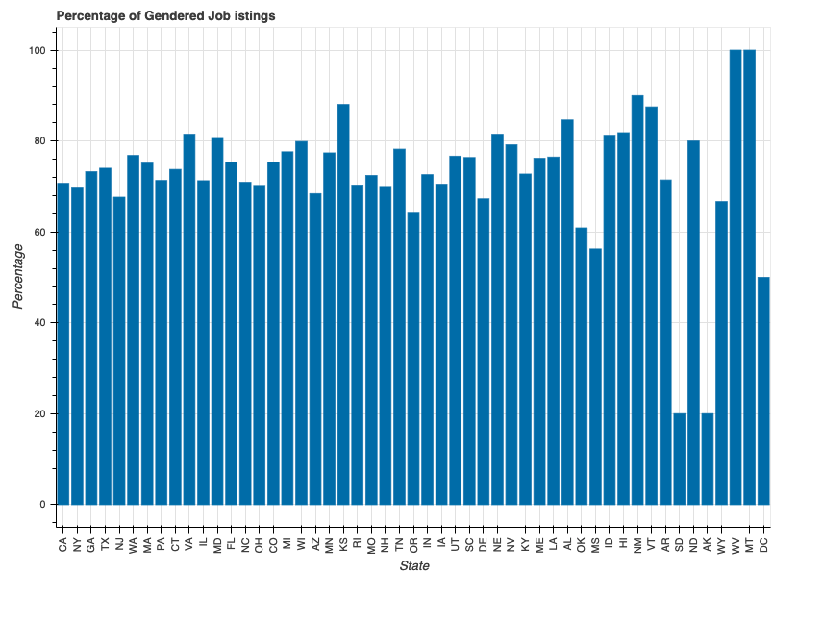
Visualizations and Results (Continued)

Slide 7
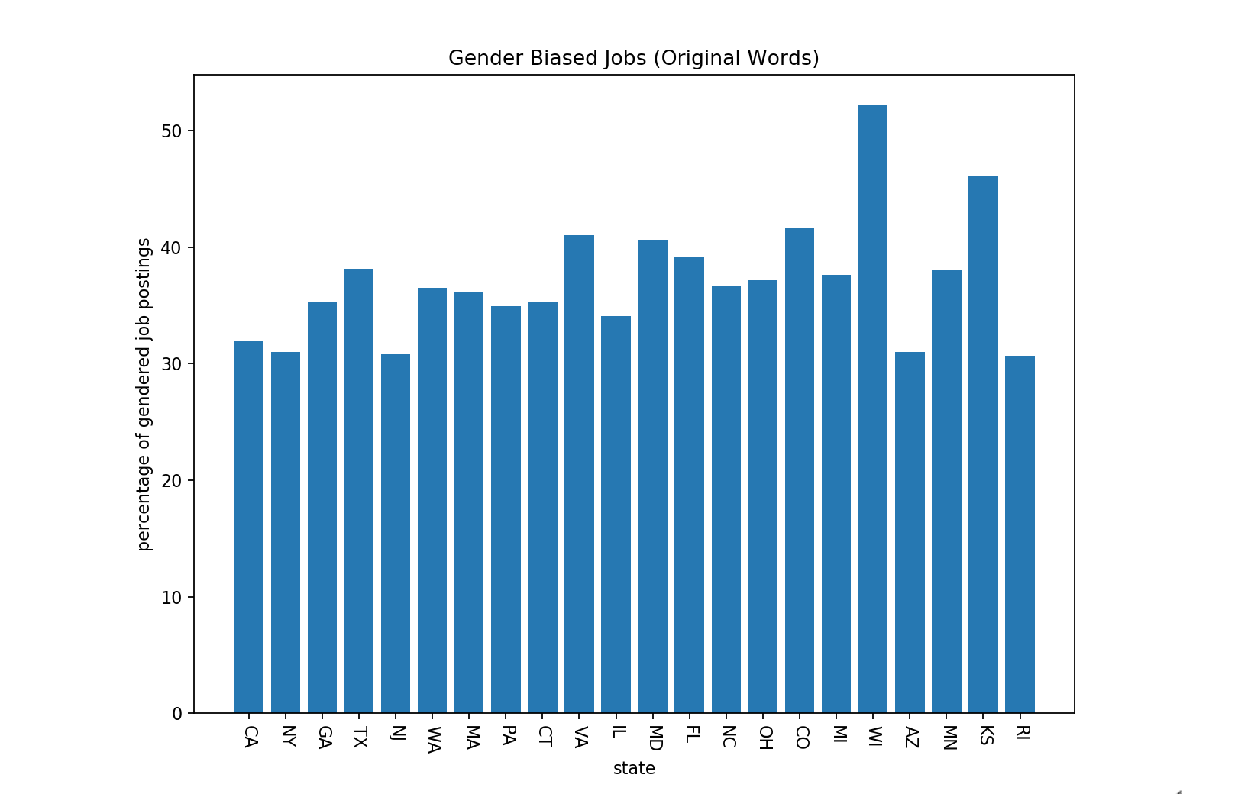
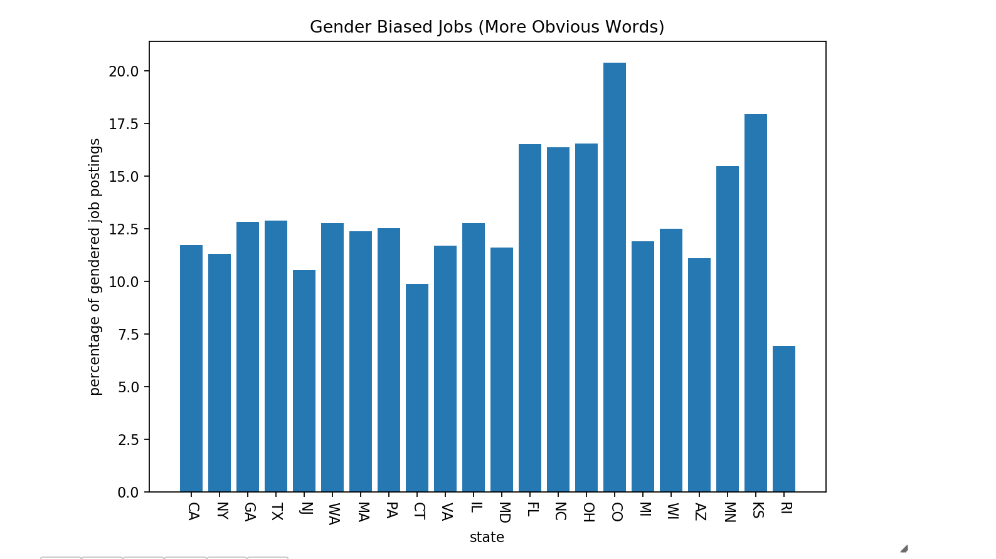
Visualizations and Results (Continued)

Slide 8
Q&A
Kyle1668/gender-specific-pronouns-analysis

